Slide 1
Std 10 Count down begins….
Children must be taught
How to think,
not What to think

Slide 2
Std 10 Count down begins….
Think before you speak
But Read before you think

Slide 3
Std 10 Count down begins….
Passing Std 10 is now on Merit only!

Slide 4
Std 10 Count down begins….
Prelim Exams Begins on
5th January 2016
Prelims are Board Exams

Slide 5
Std 10 Count down begins….
Read Text Book
80% questions are from the text books
No abbreviations
No special symbols or signs or number to be written

Slide 6
Std 10 Count down begins….
100 Hours of work for the Graded Subjects
Work Education: Vocational Guidance
RSP or Scouting or Social Service

Slide 7
Std 10 Count down begins….
Papers for Merit are selected on these features:
Neat presentation
Answers in points not essays or chunks of text.
Highlight main words
No separate subsections
Answers from Text books
Additional points to be written
No spelling errors

Slide 8
Std 10 Count down begins….
Class room discipline
Use of free time
No tolerance for indiscipline
Neat uniforms, New Uniforms
Correct and working contact numbers
Alert to instructions and time
Punctual
Clean and fresh

Slide 9
Std 10 Count down begins….
Daily Reading
Timely submission of Assignments
Neatly filed
Present before time.
Work together / Family project

Slide 10
Std 10 Count down begins….
Self Study is important
Coaching classes and other tuitions are only a support and help….
Learn by writing
Regular time to sleep and work

Slide 11
Std 10 Count down begins….
For Social Service Students and RSP
Exchange Programme with Rural Students
On Mon. 28th December 2015 to Wed 30th December 2015.

Slide 12
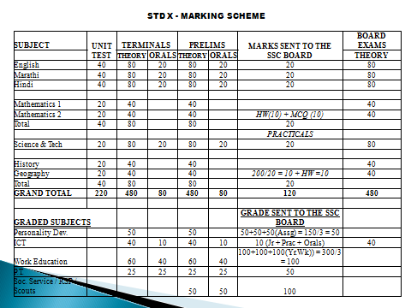

Slide 13
Std 10 Count down begins….
Kool Kampus a must for every student
www.stmarysssc.org
Yokibu.com - sms message
Valid email address and cell number

Slide 14
Std 10 Count down begins….
26th January Republic Day Celebrations
Joyful celebrations
Join the Mumbai Schools for the Parade
Marching discipline
Feeling of Togetherness and Unity
Proud to be an Indian
Exposure to other students
Imitate our Rajpath Delhi celebrations

Slide 15
Courage and Hard work is
DESTINY
Be positive and supportive

