Slide 1


Slide 2

Splash is an event organized by ST. Mary’s High School (S.S.C.)
It is a fun event organized which promises to bring out the hidden talents in students. Splash will comprise of a plethora of events that will make the experience fun-filled and entertaining by creating a blend of fun and intelligence.

Slide 3

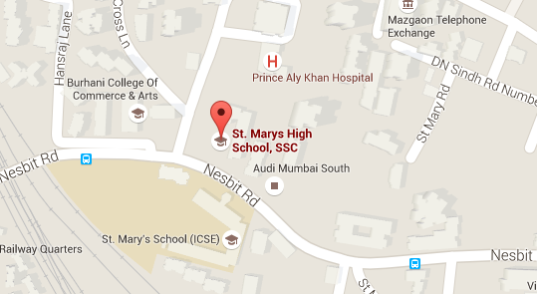
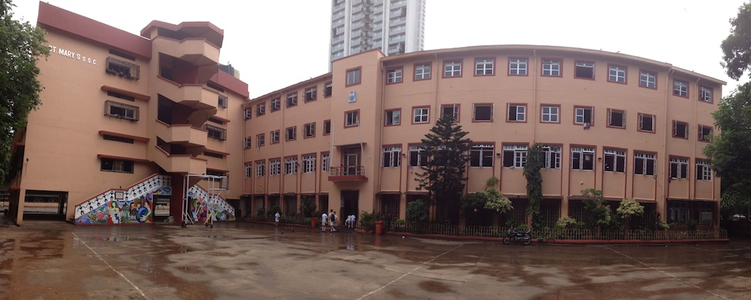
ST. MARY’S HIGH SCHOOL
[S.S.C. Section]
Mazagaon, Mumbai – 400 010
Our location

Slide 4

SCHEDULE
1. MUSIC BEATS AND TREASURE HUNT 26TH APRIL
2. DRAMA MASTI AND DANCE BUZZ 27TH APRIL
3. MR SPLASH, DJ PARTY AND 28TH APRIL
FUN FAIR

Slide 5

GENERAL RULES
The participants participating should be present before 15 minutes at the given venue.
No one should argue with organizing committee members. Students doing so, strict action will be taken against them.
If any student stays absent the whole team will be disqualified.
The decision of the judges would be final. Any team arguing may be disqualified.

Slide 6

MUSIC BEATS
Each house can send 6 participants (2 for solo and 4 for group)
Song categories- 1] Classic
2] Romantic
3] Modern
Rules-1] The song should be of only 3-4 minutes.
2] The song should be only Bollywood.
3] Participants not reaching on time, using abusive language, etc may be disqualified
Games-1] Hum saath saaz hain (Antakshri) Participants-4 (from each house).
2] Surila Kaun (Group singing).

Slide 7

TREASURE HUNT
In this event, each group has to find a thing which is called the treasure box with the help of the clues given to them. At the end the group which will have the treasure box with the maximum number of clues will be given a prize.
Rules: 1. 4 members in each group.
2. There will be 4 clues and a final clues
3. There will be 1 hour time limit
4. The 4 clues given to each team will be different from the clues given to the other teams and final clue will be the same
5. The team who first gets the treasure with all clues will be the winner.

Slide 8
DRAMA MASTI
General Information and Rules:
The skit should be in English only.
Not to go on religious matters.
Each house can send 2 to 10 members.
The skit should be of 4 minutes only.
Proper costume is compulsory.
The skit should not be adapted from any website or from YouTube of from anywhere. You should use your own brain and if the skit is copied then the team will be disqualified.
Props are allowed.
Theme=Comedy.
No abusive language allowed.

Slide 9
DANCE BUZZ
RULES
1. Each house can send 7 participants.
2. Dance may be performed in any forms.
3. Duration of one performance should be of 4 minutes.

Slide 10
MR. SPLASH
RULES
1. Mr. Splash – a personality contest which will be held on 28th April 2016.
2. Each house can send 2 participants each.
3. There would be a ramp walk, introduction round and a question-answer round.
4. Participants need to be formally dressed up.
5. The introduction should not be more than one minute.
6. No abusive language allowed during any of the rounds.

